Slide 1



Threats to Sonoran Desert Plant Species
By Emma Lintz
Dr. Helen Rowe
Northern Arizona University
AZSGC Symposium, Tempe, AZ
April 22, 2023
Notes:
Hi my name is Emma Lintz and my presentation today is on threats to Sonoran Desert Plant Species.

Slide 2
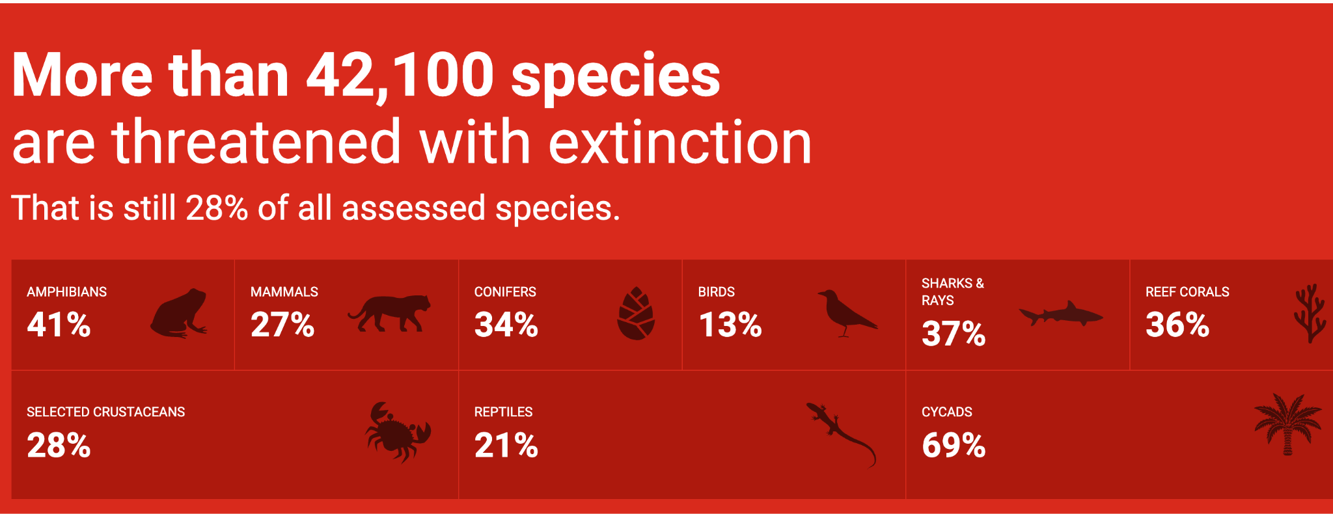
Introduction to the IUCN
Global biodiversity loss
IUCN Red List
  Assesses extinction risks of species
  Informs biodiversity conservation and policy decision making
Image from: www.iucnredlist.org/en
Notes:
So, to start off with, throughout this year I have been working with the International Union for the Conservation of Nature and just a little bit about them: they monitor global biodiversity loss. More specifically, the IUCN Red List assesses extinction risks of species through a series of protocols including monitoring, data collection, and literature reviews. The IUCN Red List is used globally to help inform biodiversity conservation and policy decision making.

Slide 3
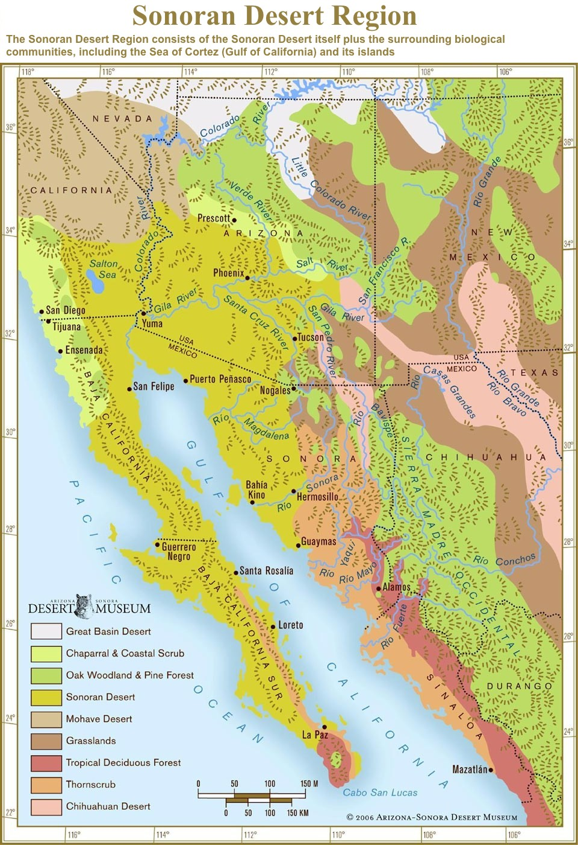
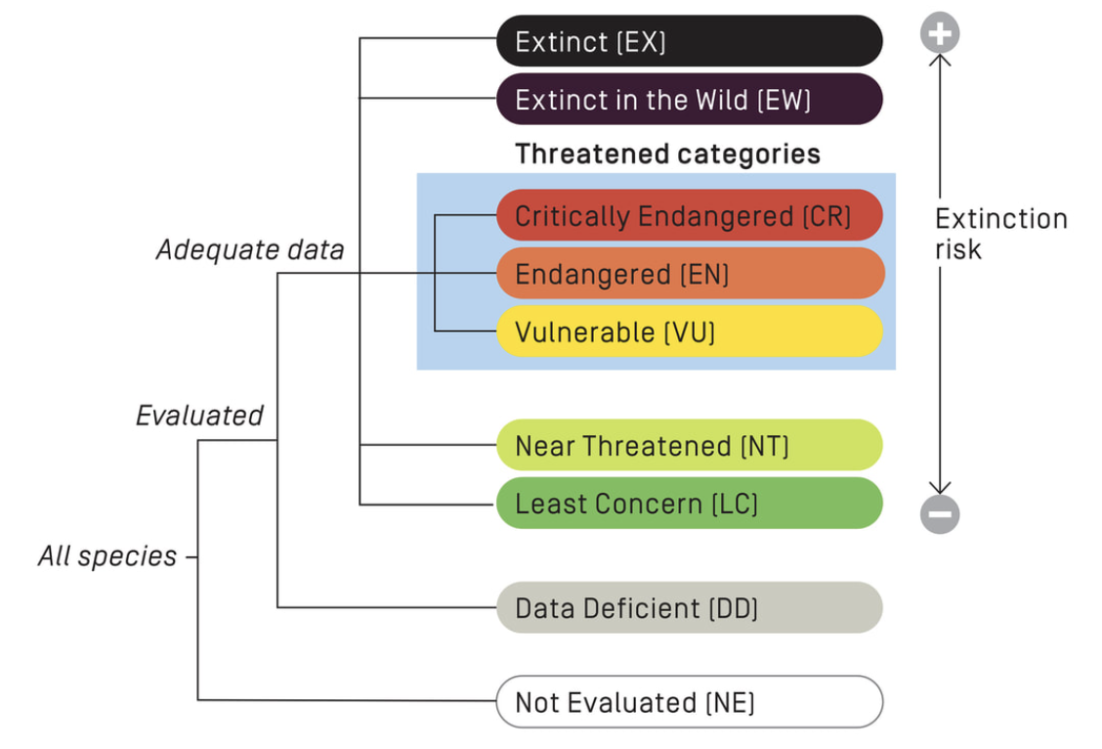
Introduction to my work
Worked with Dr. Helen Rowe and the Sonoran Desert Plants Species Specialist Group
  Assessed Sonoran Desert plant species status
    Helped assess the risk of extinction for 25 Sonoran Desert plant species (75 total)
Image from: desertmuseum.org
Image from: iucnssg.org
Notes:
My work with the IUCN was specifically with the Sonoran Desert Plant Species Specialist Group chaired by Dr Helen Rowe, my mentor this year. I helped to assess Sonoran Desert Plant Species status for the Red List. Status can range from Not Evaluated, which is still the majority of known species, to Extinct as can be seen in the image. Within my group, we worked to assess a total of 75 Sonoran Desert plant species, with my contribution of 25 species.

Slide 4
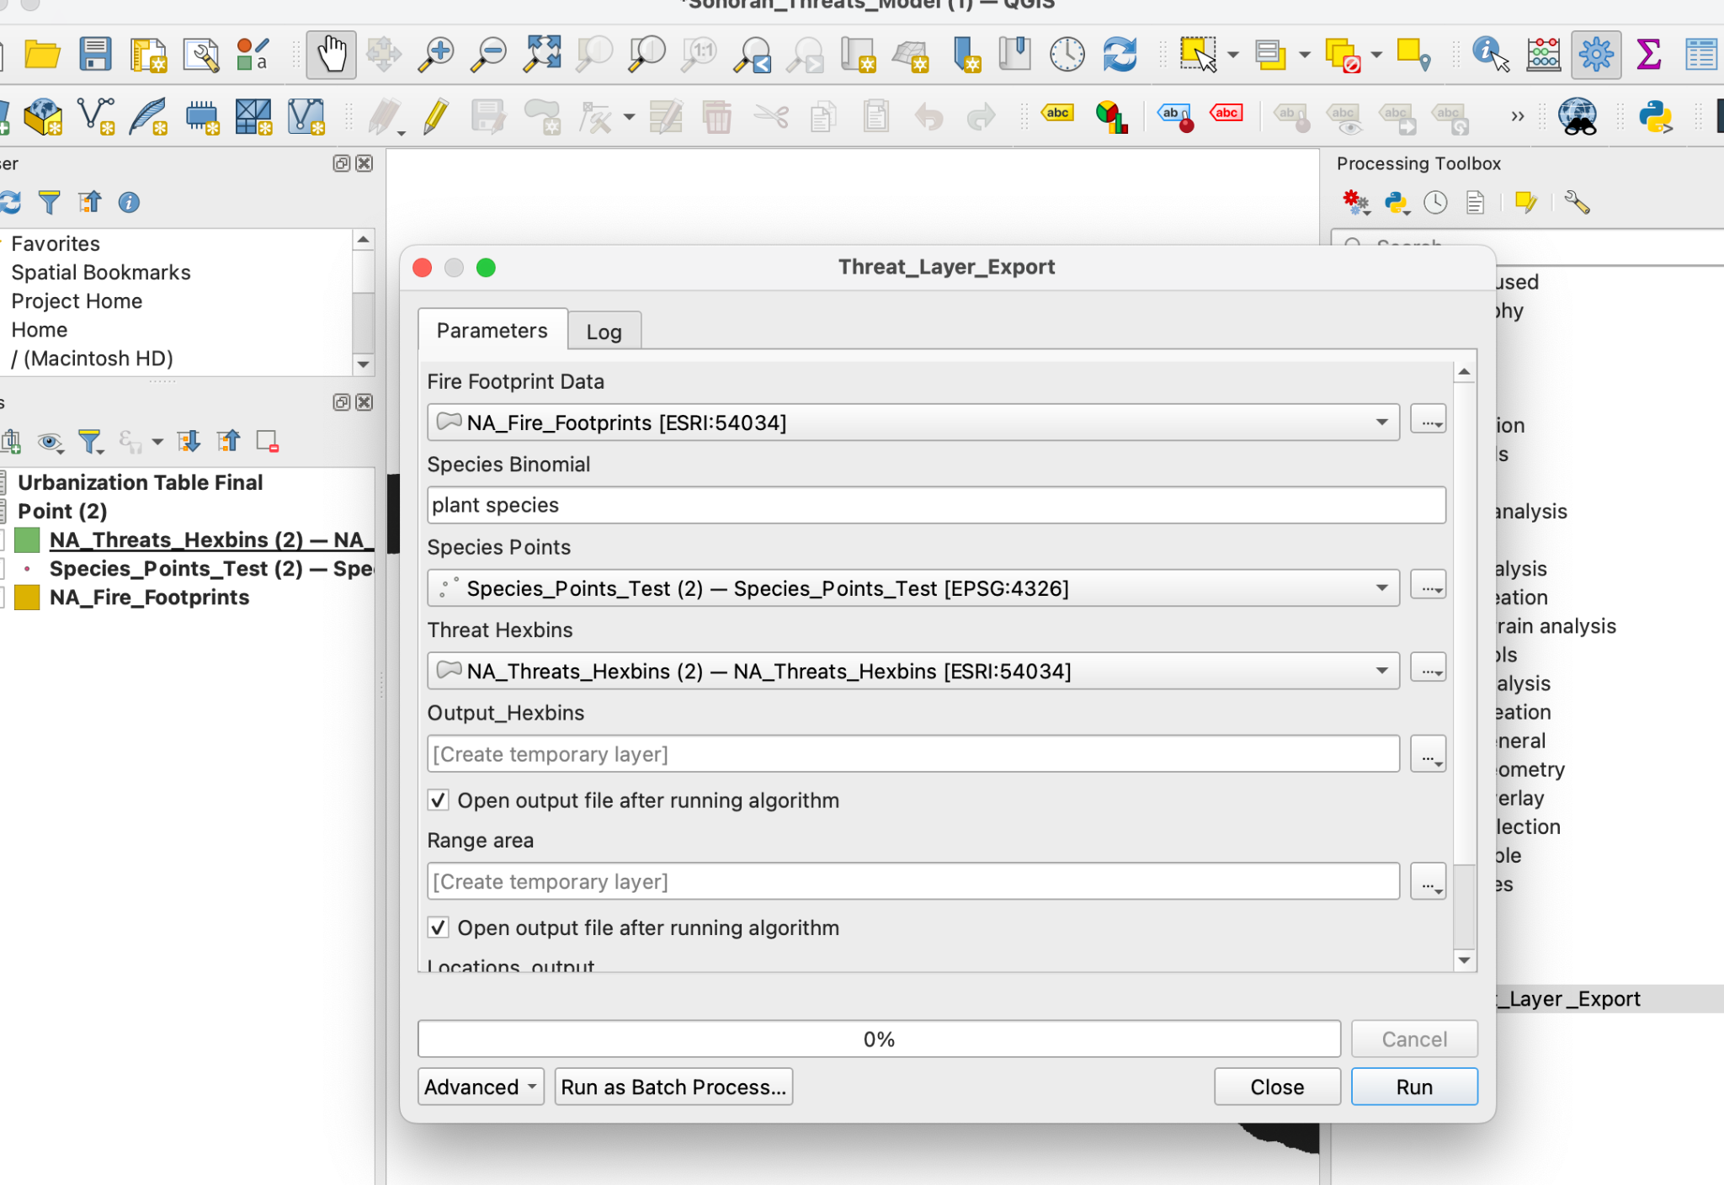
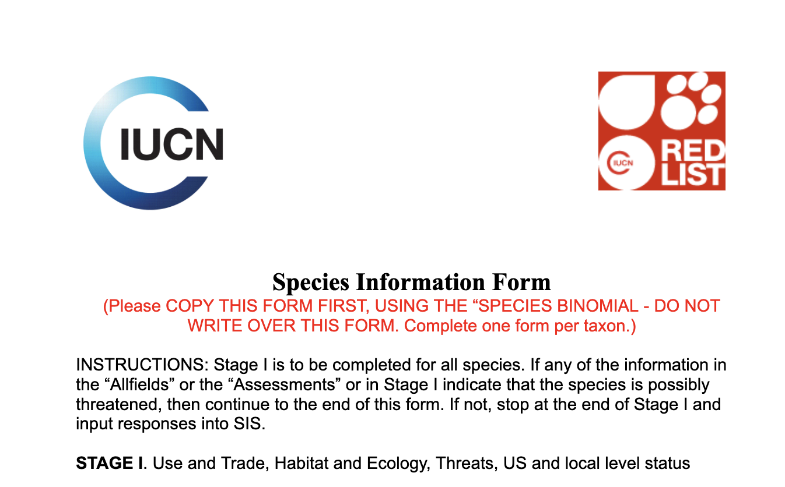
Methods
As part of the Red Listing, I filled out LC Pipeline Species Info Forms
Assessed a select number of Fabaceae we predetermined to be threatened
  QGIS program developed by Clay Meredith and Helen Rowe
Notes:
The majority of my work this year has been focused on completing Least Concert Pipeline Information Forms that help us determine whether a species is of Least Concern (meaning there is no current or predicted future threat to the species as a whole) or if it was in one of the threatened categories such as vulnerable, endangered, or critically endangered. However, the work I am going to discuss today is the threat mapping we did for a select number of Fabaceae species that were determined to be threatened. So we ran species through a QGIS program developed by Clay Meredith and Helen Rowe. You can see the model they created in the top right corner of the screen with the different parameters.

Slide 5
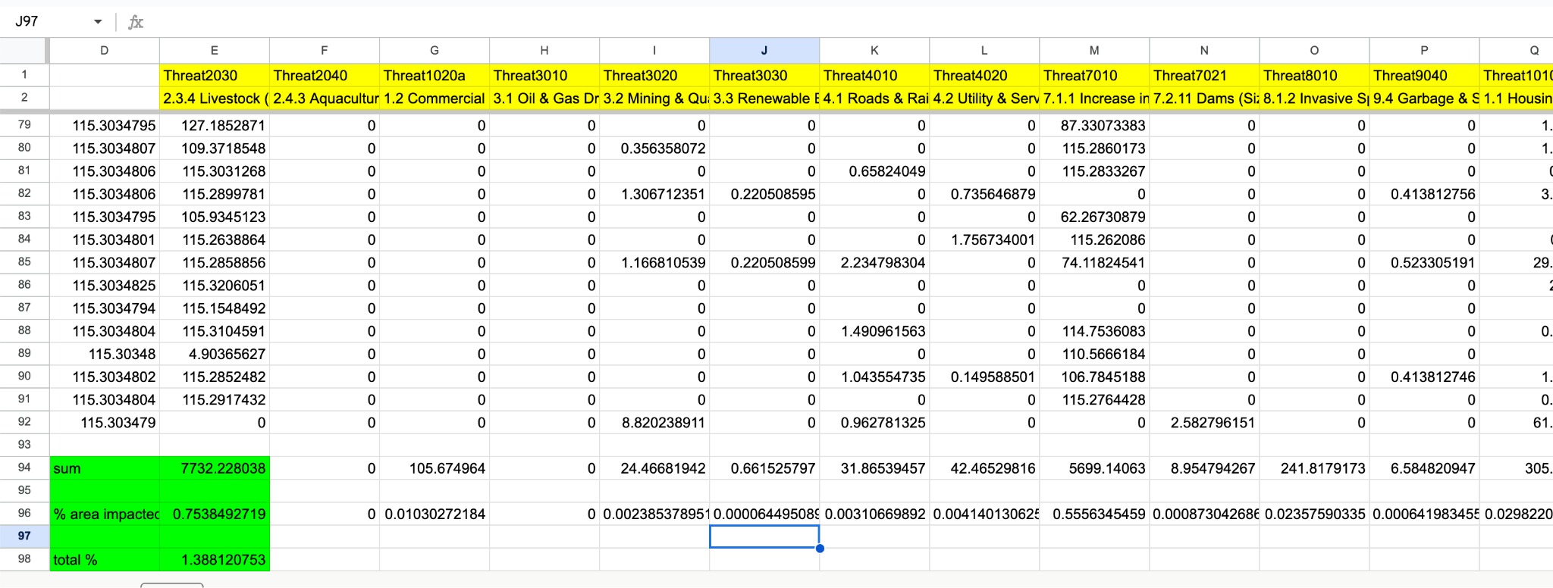
Methods
QGIS output threats
Calculated percent of species’ range impacted by threats
Notes:
Then when the model was run, it spit out a table like this that gave the different threats as highlighted in yellow and the amount of its range in km that were impacted by these threats. To determine the percentage of each species range impacted, we took the sum of each threat’s area and divided it by the total range area to get percentage of each threat in the species range. The final step for this was to add up the percentage to determine total percentage of the species range impacted by potential threats. Sometimes, the total percentage was over 100%, which is due to overlapping threats.

Slide 6
Results
Fabaceae | Fire Locations | Protected Land | Threatened Range
Astragalus arizonicus | 635 | 12% | 100%
Astragalus aridus | 359 | 31% | 33%
Astragalus allochrouos | 2044 | 20% | 100%
Acaciella lemmonii | 849 | 2% | 15%
Sphinctospermum constrictum | 3838318133 | 31% | 30%
Indigofera sphaerocarpa | 856690107 | 21% | 88%
Lathyrus laetivlrens | 1441127083 | 38% | 100%
Notes:
So we have a total of 15 species that were mapped for threats and we created a table from this data. The fire locations means that there are so many distinct locations according to the mapping for each species range and it would take x amount of fires to destroy its entire range. So the larger the number of fire locations the less vulnerable the species is to fire. Protected land can range from tribal land to BLM land to national parks and forests. Percentage of threatened range is how much land could possibly be threatened by these different disturbances.

Slide 7
Results
Fabaceae | Fire Locations | Protected Land | Threatened Range
Desmodium scopulorum | 864874011 | 40% | 49%
Desmodium psilocarpum | 1376359658 | 42% | 51%
Mimosa gentryi | 274 | 7% | 5%
Astragalus magdalena | 1616 | 100% | 8%
Brongniartia minutifolia | 23 | 99% | 23%
Desmanthus covillei | 1819 | 19% | 37%
Desmodium arizonicum | 274 | 14% | 70%
Dalea tentaculoides | 28 | 20% | 16%
Protected Land Range: 2-100%
Protected Land Average: 33%
Threatened Range Range: 5-100%
Threatened Range Average: 48%
Notes:
From this data we found the ranges and averages for each category and I just want to mention that the average for protected land within these species range is 33% and the average for the threatened range is 48%.

Slide 8
Results
Most widespread threats across all species’ ranges:
Livestock (grazing)
Urbanization (housing and commercial/industrial areas)
Crops
Increase in fire severity and frequency
Notes:
Within each species threatened range, we found common threats that were widespread including livestock in the form of grazing, urbanization such as housing or commercial areas, crop development, and an increase in fire severity and frequency.

Slide 9
Discussion
Disturbance constitutes a threat depending on each species’ characteristics and response
Livestock is the most widespread threat
  Should be noted that some plant species benefit from grazing
Amount of protected range varied widely and not all protected land status are equal
Future conservation measures
  Protecting threatened species’ ranges
Future research into overlapping threats and the plants’ response to threats
Notes:
First, I would like to note that the disturbances we discussed only constitute a threat if the plant species has an adverse reaction to it. For instance, we found that livestock is the most widespread disturbance according to our mapping , but some species actually benefit from grazing so livestock would not be a threat. I would also like to discuss that the amount of protected range varied widely from 2 to 100% of its range and not all protected land status is equal. For instance, a species within a national park has more protections than one that falls within blm land. Obviously, conservation measures should include protecting each threatened species ranges and ensuring protections are adequate so their range does not continue to decline. And future research I would suggest is seeing how much of each species range has overlapping threats and how these overlapping threats might further stress the plants than if it was just one.

Slide 10
Acknowledgements
Dr. Helen Rowe
Clay Meredith
Linda Howard
Arizona Space Grant Consortium
Lydia Mussack
Annika Dillemuth
McDowell Sonoran Conservancy
Notes:
I’d like to acknowledge my amazing mentor this semester, Dr Helen Rowe, as well as Clay Meredith who worked to develop out QGIS Model, Linda Howard who worked closely with us on the Fabaceae. I would also like to acknowledge the AZ Space Grant Consortium for funding this research. Also acknowledging Lydia Mussack and Annika Dillemuth, my wonderful team members on this project, and the McDowell Sonoran Conservancy for providing us data on the Sonoran Desert Plants.

Slide 11
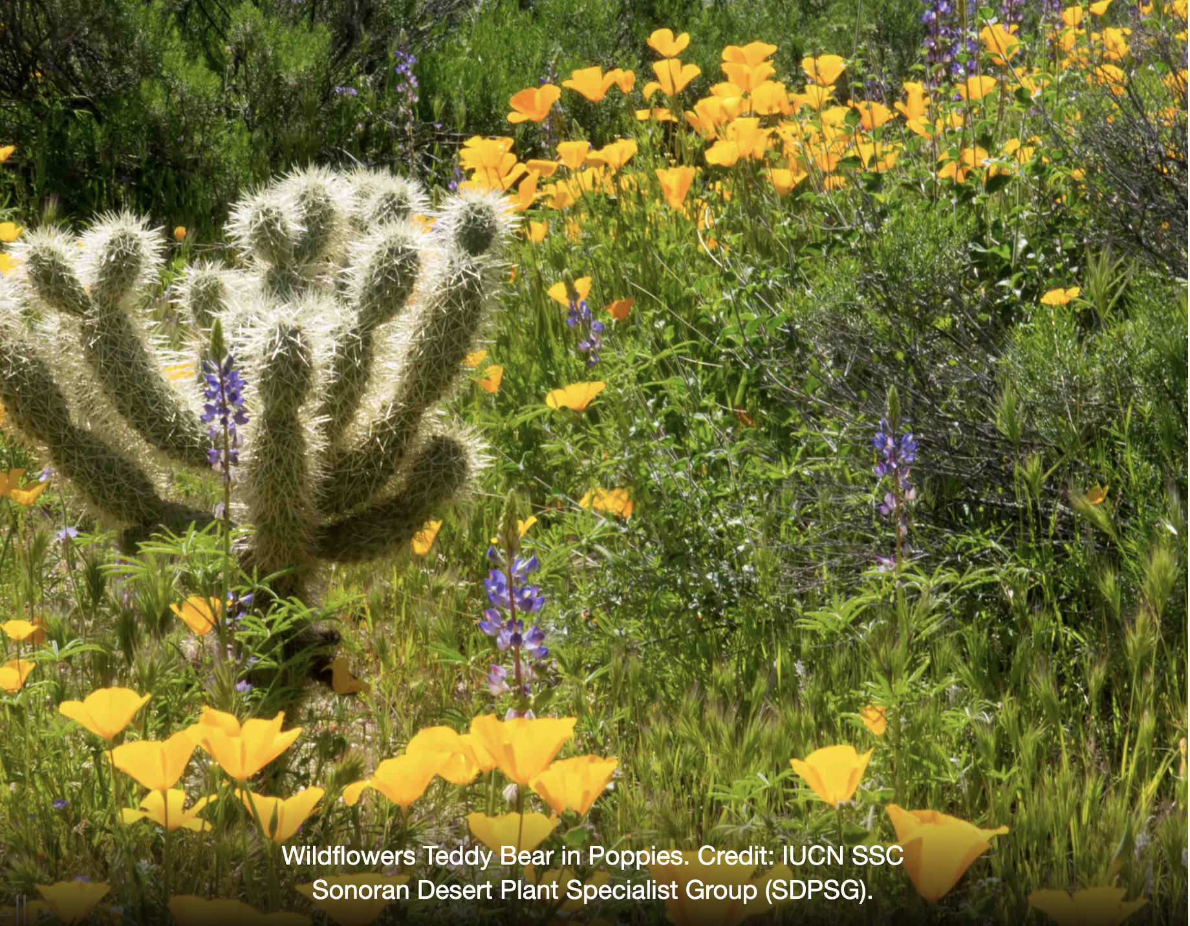
Thank You!
Notes:
Thank you!

